Slide 1
Physical Layer Network Coding in Two-Way Relaying Systems
Sino-German Workshop, 04/03/14 - 07/03/14, Shenzhen
Dirk Wübben, Yidong Lang, Meng Wu, Armin Dekorsy
TexPoint fonts used in EMF.
Read the TexPoint manual before you delete this box.: AAAAAAA

Slide 2
Research in a nutshell
Compressed Sensing Carsten Bockelmann
In-Network-Processing Henning Paul
Cooperative Communications Dirk Wübben
CS-MUD
Joint data and activity detection
Distributed CS
Projects:
DFG: NiCoM, CoSeM, INNS
EU: METIS
Applications: Massive M2M communication , invasive neuronal signal recording
Publications (2012-2013): ETT Journal, 9 conferences
Distributed linear and non-linear estimation
Consensus-based estimation and detection (DICE-Algo)
Projects:
Uni-Bremen
EU: iJoin
Applications: Environmental monitoring, 5G -ultra dense networks (small cells)
Publications (2012-1013): IEEE Letter, 6 conferences
Network coding
Two-way-relaying, multi-hop-relaying (IDMA)
Waveform design
Projects:
DFG: COINII, COINIII
EU: METIS, iJoin
Industry
Applications: 5G: D2D, relaying networks, ultra-dense networks
Publications (2012-2013): 1 book chapter, 2 journals, 11 conferences

Slide 3
Overview
Two-Way-Relay system with Physical Layer Network Coding
Channel Decoding and Physical Layer Network Coding schemes
Separate Channel Decoding (SDC)
Joint Channel decoding and physical layer Network Coding (JCNC)
Generalized JCNC (G-JCNC)
Simulation results
Implementation aspects
Hardware testbed
Carrier Frequency Offset analysis

Slide 4
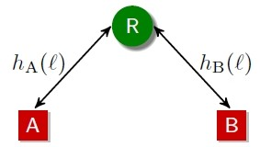
Introduction
Two-Way-Relaying system: Two sources A and B exchange information assisted by a relay R
Assumptions:
Half-duplex constraint: no simultaneous transmission and reception
No direct communication link between A and B
Relay processing:
Processing at relay is crucial for end-to-end performance
Physical layer network coding (PLNC) to combine both received signals
Objective: Design of joint decoding and PLNC schemes at relay

Slide 5
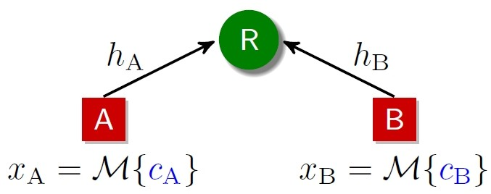
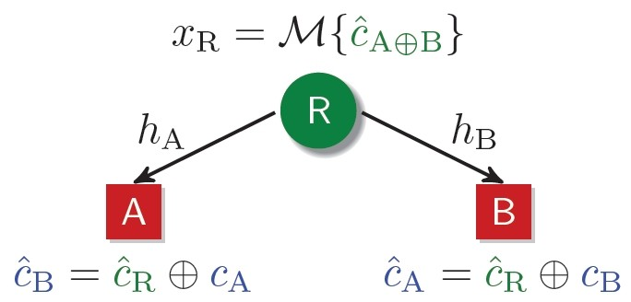
Physical Layer Network Coding
Phase l (Multiple access)
A and B use same code Γ (e.g. LDPC) with c_{A} and c_{B} as codewords
M: modulation scheme
A and B transmit simultaneously to R
R estimates relay codeword $\hat{\text{c}}$_{A⊕B} using superimposed signal y_{R}
Challenge: How to estimate $\hat{\text{c}}$_{A⊕B} from y_{R} ?
Joint channel decoding and PLNC
Separated channel decoding (SCD)
Joint channel decoding and physical layer network coding (JCNC)
Generalized JCNC (G-JCNC)
Phase ll (Broadcast)

Slide 6
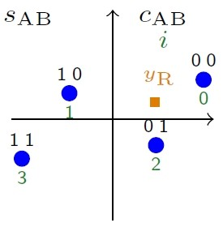
Some definitions (examplary for BPSK, M=2)
Decoding acts on superimposed noise-free receive signal
BPSK with x_{A}, x_{B} $∈${$±1$}: s_{AB} has at most M² =4 constellation points (hypotheses) with s_{AB} $∈$ S_{AB} and S_{AB} as set of hypotheses
Define code symbol tuple c_{AB} = [c_{A} c_{B}] $∈$ C_{AB}
A-posteriori probability (APP) of i-th hypothesis with i=0..3
Mapping:
∼
i | c_{A} | c_{B} | c_{A⊕B} | c_{AB} | x_{A} | x_{B} | s_{AB}
0 | 0 | 0 | 0 | 0 | 1 | 1 | h_{A}+h_{B}
1 | 1 | 0 | 1 | 1 | -1 | 1 | - h_{A}+h_{B}
2 | 0 | 1 | 1 | D | 1 | -1 | h_{A}-h_{B}
3 | 1 | 1 | 0 | 1+D | -1 | -1 | -h_{A}-h_{B}

Slide 7
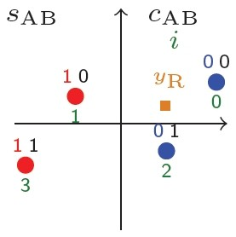
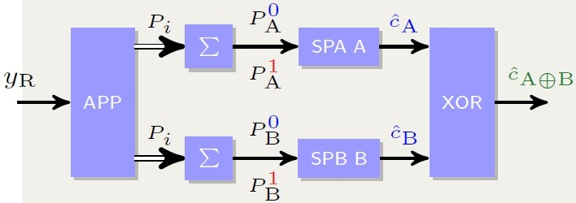
Separated Channel Decoding (SCD)
Idea: Estimate code symbols c_{A} and c_{B} explicitly and apply succeeding XOR operation to obtain $\hat{\text{c}}$_{A⊕B}
Calculate APPs for c_{A} and c_{B}
Perform symbolwise decoding for each source by sum-product algorithm (SPA)
Interpretation as common multiple access problem (counterpart is processed as interference)
e.g. for c_{A}
Parallel SCD (P-SCD)
Serial SCD (S-SCD): cancel interference caused by A for B

Slide 8
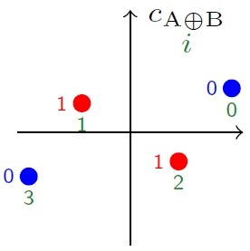
Joint Channel Decoding and Physical Layer Network Coding (JCNC)
Idea: If we assume code Γ to be linear then $\hat{\text{c}}$_{A⊕B}= c_{A} ⊕ c_{B} is a valid codeword
→ Perform decoding of codeword $\hat{\text{c}}$_{A⊕B} without explicitly decoding c_{A} and c_{B}
Calculate APPs for codesymbol c_{A⊕B}
Perform symbolwise decoding for c_{A⊕B} using SPA

Slide 9
Generalized JCNC (G-JCNC)
Idea: Perform decoding on hypotheses for combined code symbols c_{AB} = [c_{A} c_{B}] $∈$ C_{AB} with succeeding mapping on $\hat{\text{c}}$_{A⊕B}  jointly decode two codes by a generalized Sum-Product Algorithm (G-SPA)
G-SPA: decodes code symbol tuples c_{AB} = [c_{A} c_{B}]^{T}
Combining code symbols [c_{A} c_{B}]^{T} ${\text{F}}_{2}^{2}$ leads to new code with codewords of size 2xN defined by parity-check equation
Binary parity-check matrix H of code Γ  we can use factor graph of code Γ
Decoder calculates APPs for each codesymbol c_{AB}
PLNC mapping: Mapping of codesymbol c_{AB} with maximum APP to XOR symbol $\hat{\text{c}}$_{A⊕B}
We can alternatively represent code symbol tuples c_{AB} = [c_{A} c_{B}]^{T} by quaternary symbols c_{AB} ${\text{F}}_{4}^{}$  decoder over ${\text{F}}_{4}^{}$

Slide 10
Generalized JCNC (G-JCNC)
Receiver block for G-JCNC
$\hat{\text{c}}$_{A⊕B}
Generalized SPA for ${\text{F}}_{4}^{}$
PLNC mapping
G-SPA4 delivers APP vector for each c_{AB}
PLNC mapping rule (BPSK)

Slide 11
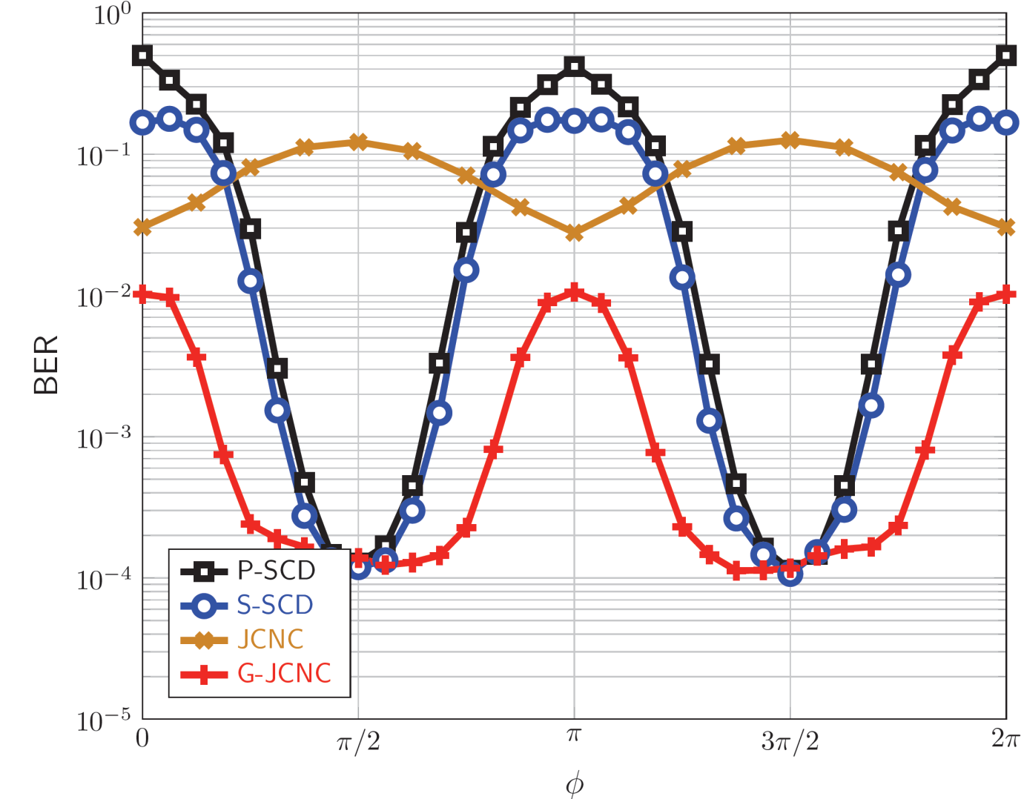
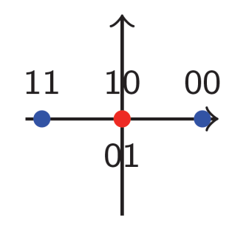
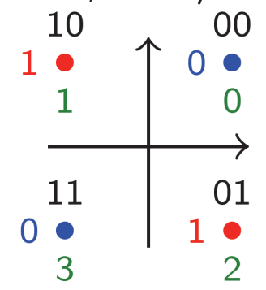
Ambiguity of constellation points/hypotheses
$φ=0$ (AWGN)
$$φ= π/2$$
SCD very sensitive due to problem of ambiguity
JCNC robust but generally shows low performance
G-JCNC quite robust and always shows best performance
LDPC with code length N=1000, R_{c}=0.4, 10 iterations per SPA, h_{A}=1 and h_{B}=$e^{j\text{Á}}$, fixed E_{b}/N₀ = 3 dB

Slide 12
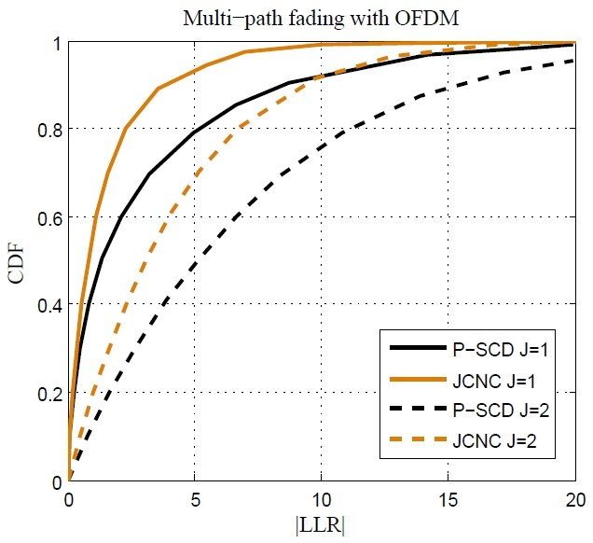
LLR-Distributions
OFDM: Fro each subcarrier we receive different signal constellations
Diverse channel coefficients (h_{A} and h_{B} ) are advantageous to SCD
Additional antenna (J=2) at relay does not change relation
LDPC, 1024 subcarrier, QPSK, SNR = 5 dB

Slide 13
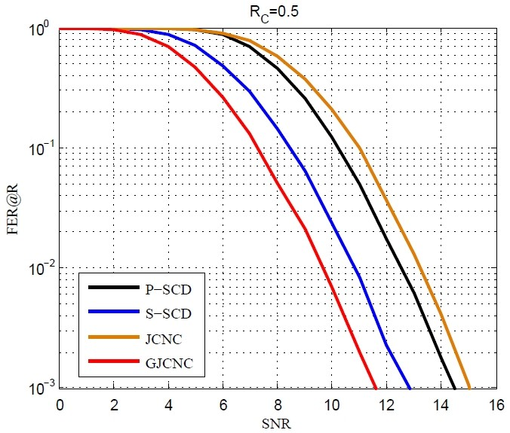
FER at relay for OFDM
G-JCNC outperforms all other schemes
SCD better than JCNC
Claims also valid for other code rates
LDPC, each OFDM symbol individually encoded, 1024 carriers, 100 iterations per SPA, single antenna relay

Slide 14
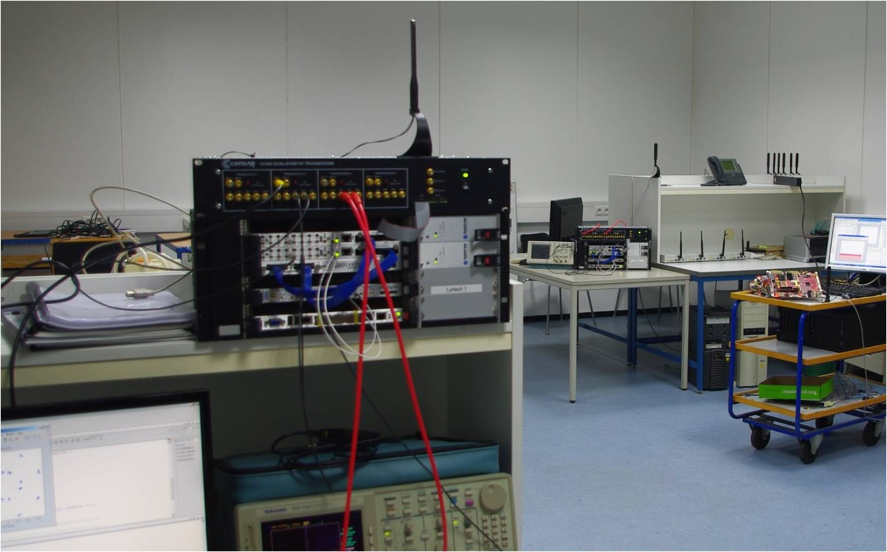
Hardware Plattform
source A
source B
relay
Real time implementation of basic LTE Rel8 Downlink phy-layer processing
Objective: test of different decoding schemes (SCD, JCNC, GJCNC) with carrier-frequency-offset (CFO) impairments

Slide 15
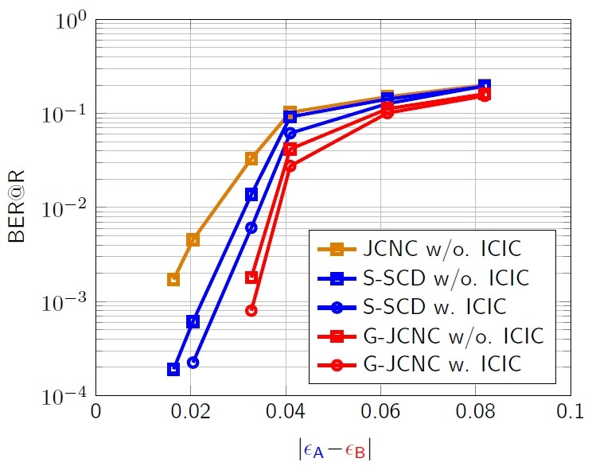
Carrier Frequency Offset (CFO) analysis: Test-bed results
BER measured at relay
Performance loss with increasing CFO difference
Measured performances confirm simulation results  G-JCNC with best performance
normalized CFO ²_{i}= ¢f_{i}T_{S}, with i = A,B
¢f_{i}: carrier offset, T_{S} : OFDM symbol duration

Slide 16
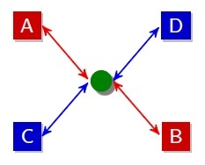
Further research activities on relaying
5G: EU-Project METIS
Mobile and wireless communications Enablers for the Twenty-Twenty (2020) Information Society
Bi-directional Relaying with non-orthogonal medium access
Two-way relaying with multiple flows and multiple communication pairs
Application of Interleave Division Multiple Access (IDMA) as non-orthogonal medium access
Conceptual design studying rate adaptation and power allocation and the design of transmitter and receiving schemes

Slide 17
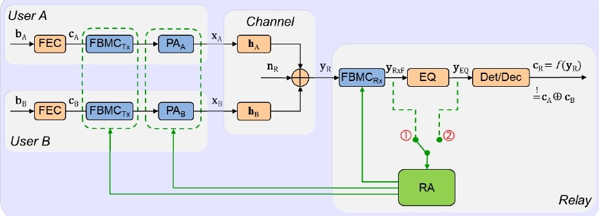
Further research activities on relaying
Research project with University of Rostock
Joint Optimization of Generalized Multicarrier Waveforms and Power Allocation for Two-Way Relay Systems
Coded Filter Bank Multicarrier (cFBMC) for two-way relay system
Derivation of two-way relay MAC-system model
Design of novel cFBMC receiver concepts to estimate common relay message
Development of joint impulse shaping and power allocation strategies
System design with high scalability for balancing complexity & performance

Slide 18
Thank you very much for your attention!

Slide 19
References
D. Wübben: Joint Channel Decoding and Physical-Layer Network Coding in Two-Way QPSK Relay Systems by a Generalized Sum-Product Algorithm, ISWCS 2010, York, UK, Sept. 2010
D. Wübben, Y. Lang: Generalized Sum-Product Algorithm for Joint Channel Decoding and Physical-Layer Network Coding in Two-Way Relay Systems, GLOBECOM 2010, Miami, USA, Dec. 2010
M. Wu, D. Wübben, A. Dekorsy: Mutual Information Based Analysis for Physical-Layer Network Coding with Optimal Phase Control, SCC 2013, Munich, Germany, Jan. 2013
M. Wu, D. Wübben, A. Dekorsy: Physical-Layer Network Coding in Coded OFDM Systems with Multiple-Antenna Relay, VTC 2013-Spring, Dresden, Germany, Jun. 2013
F. Lenkeit, C. Bockelmann, D. Wübben, A. Dekorsy: IRA Code Design for IDMA-based Multi-Pair Bidirectional Relaying Systems, BWA 2013, GLOBECOM Workshop, Atlanta, USA, Dec. 2013
M. Wu, F. Ludwig, M. Woltering, D. Wübben, A. Dekorsy, S. Paul: Analysis and Implementation for Physical-Layer Network Coding with Carrier Frequency Offset, WSA 2014, Erlangen, Germany, Mar. 2014 (accepted)
D. Wübben, M. Wu, A. Dekorsy: Physical-Layer Network Coding with Multiple-Antenna Relays, Chapter in MIMO Processing for 4G and Beyond: Fundamentals and Evolution, CRC Press, Apr. 2014

Slide 20
Backup

Slide 21
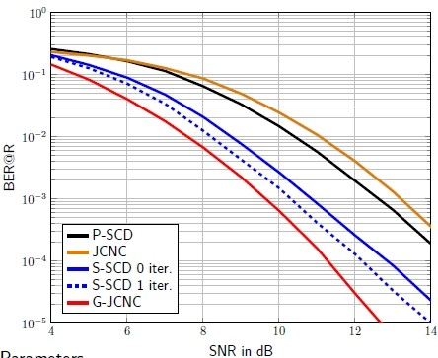
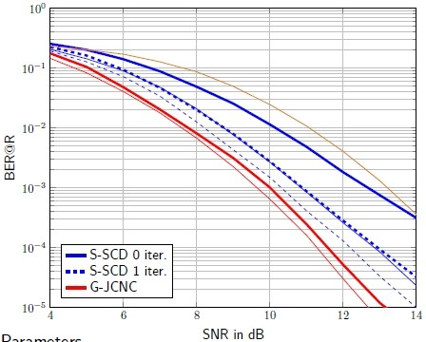
CFO analysis: Simulation results
CFO  Inter-Carrier Interference
Techniques applied: CFO compensation and Inter Carrier Interference Cancellation (ICIC)
No CFO
CFO with ICIC
G-JCNC outperforms other coding schemes
G-JCNC achieves almost performance of CFO-free case if ICIC is applied

Slide 22
Ambiguity of constellation points/hypotheses
$φ=0$ (AWGN)
i | c_{A} | c_{B} | c_{A⊕B} | c_{AB} | s_{AB}
0 | 0 | 0 | 0 | 0 | 2
1 | 1 | 0 | 1 | 1 | 0
2 | 0 | 1 | 1 | D | 0
3 | 1 | 1 | 0 | 1+D | -2
SCD: s_{AB}=0  ambiguity for c_{A} and c_{B}
JCNC: s_{AB}=0 ) $\hat{\text{c}}$_{A⊕B} =1 and s_{AB} $∈${$±2$}: ) $\hat{\text{c}}$_{A⊕B} =1  no ambiguity
G-JCNC: 3 hypotheses to decode for 4 code symbols c_{AB}  ambiguity
$φ= π/2$: four constellation points
SCD and GJCNC: no ambiguity  performance improvement
JCNC: reduced Euclidian distance  performance loss

Slide 23
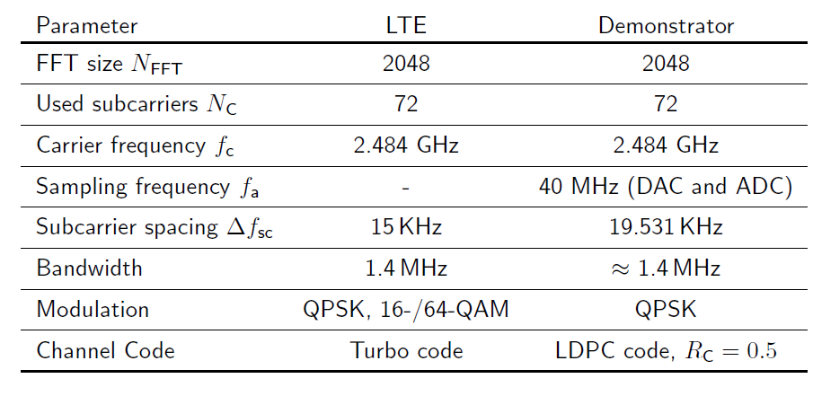
Testbed set-up: OFDM transmission
Define: normalized CFO ²_{i}= ¢f_{i}T_{S}, with i = A,B

Slide 24
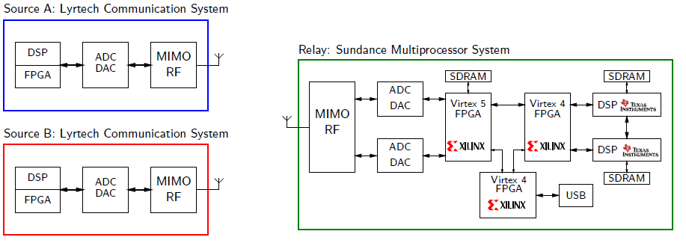
Testbed set-up
Flexible hardware solution
Baseband processing can be partitioned in DSPs and FPGAs
RF transceivers for 2.4 GHz and 5 GHz ISM bands

Slide 25
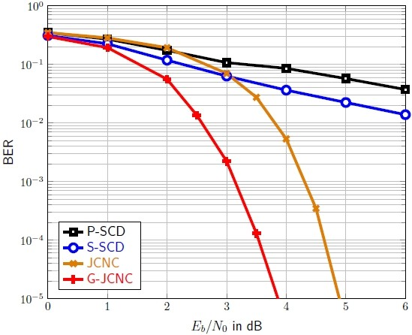
End-to-End BER: Normalized Block Fading Channels
Parameters:
LDPC with code length N=1000, R_{c}=0.4
10 iterations per SPA
Normalized block fading channel h_{A}=1 and h_{B}=$e^{j\text{Á}}$ with Á ∼ U(- ¼, ¼)
Received signal points may overlay
P-SCD and S-SCD perform worst
Improved performance by JCNC
G-JCNC outperforms common approaches significantly ( 1dB gain at BER 10⁻⁵)

Slide 26
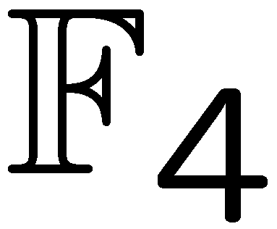
Summary
Physical Layer Network Coding (PLNC) requires only 2 transmission steps
Generalized Joint Channel Decoding and Physical Layer Network Coding (G-JCNC)
Generalized Sum-Product Algorithm over performs joint decoding of both channel codes
Strong performance improvements and robustness
Generalization for higher order modulation
Practical aspects, e.g., Carrier Frequency Offset (CFO)
Introduces Inter Carrier Interference (ICI)
ICI cancelation (ICIC) with modified S-SCD and G-JCNC results in only small performance degradation with moderate CFO

Slide 27
Two-Way-Relaying: System Model

Slide 28
Current Investigations
Joint DFG project with Institute for Electrodynamics and Microelectronics:
Physical Layer Network Coding in Two-Way Relaying Systems with Multiple-Antenna Relays or Distributed Single-Antenna Relays
Extension to multiple-antenna relays and distributed relays
Investigation of implementation cost and efficient hardware
Proof of concept by real-time testbed
Realization aspects, e.g., carrier frequency offset (CFO)

